Slide 1

August Email Marketing Report
For All Line

Slide 2
Campaign SMART goals & activities
Goal 1: Grow the email subscriber list by 12,000 people by the end of September by partnering with social and paid media specialists and launching an email referral program that offers discounts to existing subscribers
Goal 2: Increase the monthly conversion rate of current subscribers by 2% within six months of launch by segmenting the email list for the For All line of products.

Slide 3
Campaign KPIs
New subscribers added
Conversion rate
Open rate
Click-to-open rate

Slide 4
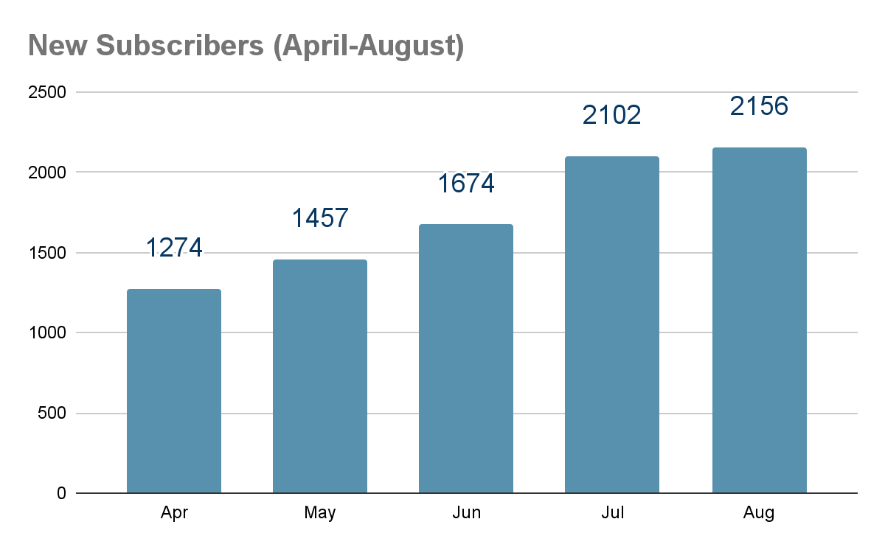
New email subscribers added
Goal
12K new subs by end of Sept.
Gap to target
Aug: 3,337
Launch
Notes:
Summary: We are bound to get at least 2000 subs in September if the trend continues. If we gain 2000 in september we will miss the goal by 1337. There is a significant increase in new subscribers after the launch of the campaign.
Recommendations:

Slide 5
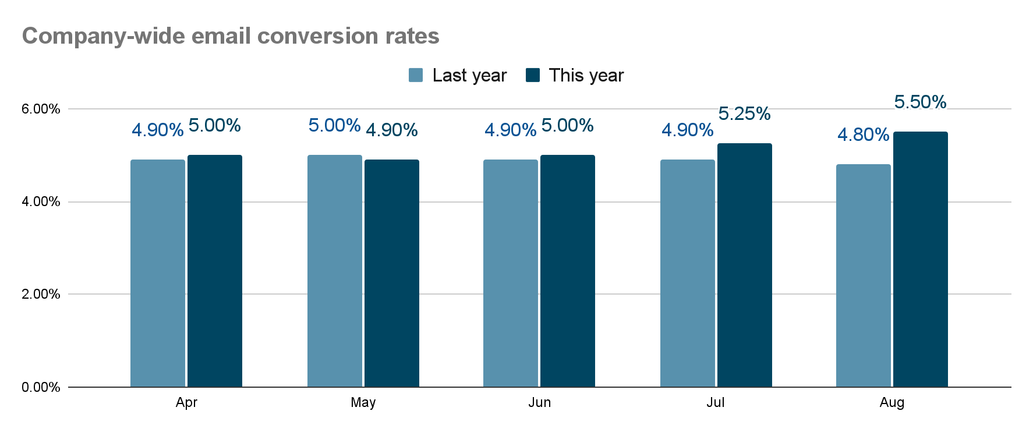
Monthly conversion rates
Goal
Increase 2% by end of Dec.
Launch
Notes:
Summary: After the launch of the campaign our conversion rates is steadily increasing by .25%. If we compare our conversion rate last year to this year after the launch of the campaign we can see that we improved our conversion rate. If the trend line stays the same we will miss our goal to increase conversion rate by 2% at the end of December.
Recommendations:

Slide 6
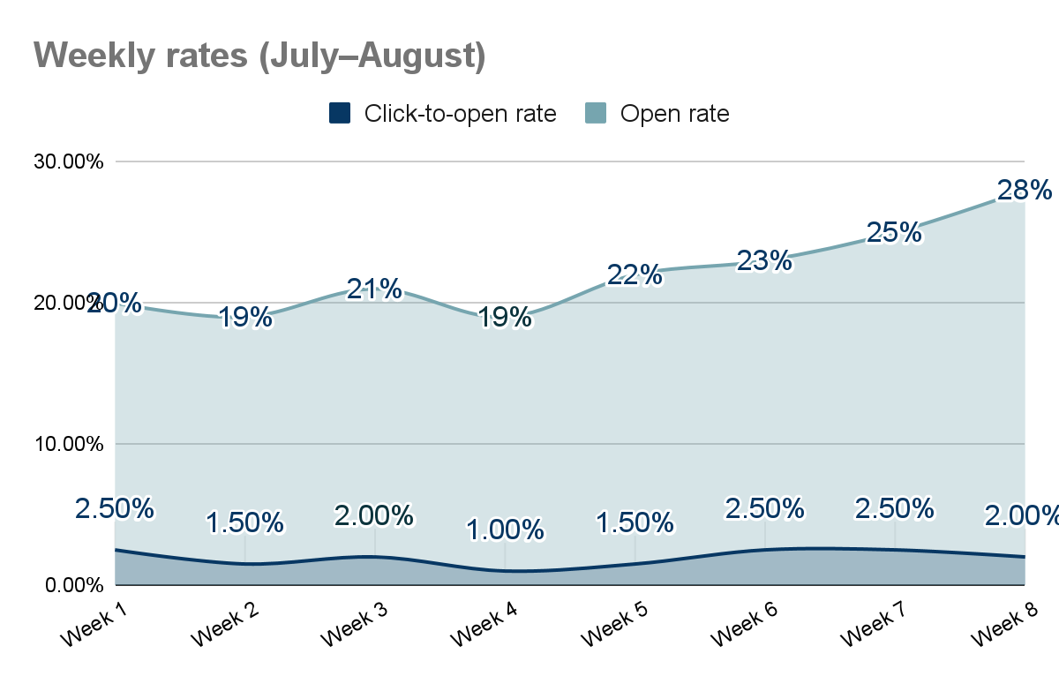
Weekly open rates vs. click-to-open rates
Industry benchmarks
Open rate: 20%
Click-to-open rate: 3%
Notes:
Summary: On average we are above the benchmark for open rates. We also show a steady increase on open rate as the week goes by. We are underperforming in click-to-open rate when compared to the industry benchmark. We need to improve our call to action.
Recommendations:

Slide 7
Conclusion and next steps
If we do not improve the For All campaign then we will not meet our goal.
I suggest we improve our campaign by improving the body of our email and our call to action. As the click-to-open rate shows we are not enticing our customer to click on the button when they open the email.
We can run a special discount during the campaign to incentives our customers to take the desired action we want.

